Slide 1
The Shasta Tribe
Today we will research some specific Native American tribes.
We will learn:
where they lived
what resources they used and why
What they used as “money”
What their religious beliefs were, and
What the tribe members’ responsibilities were

Slide 2
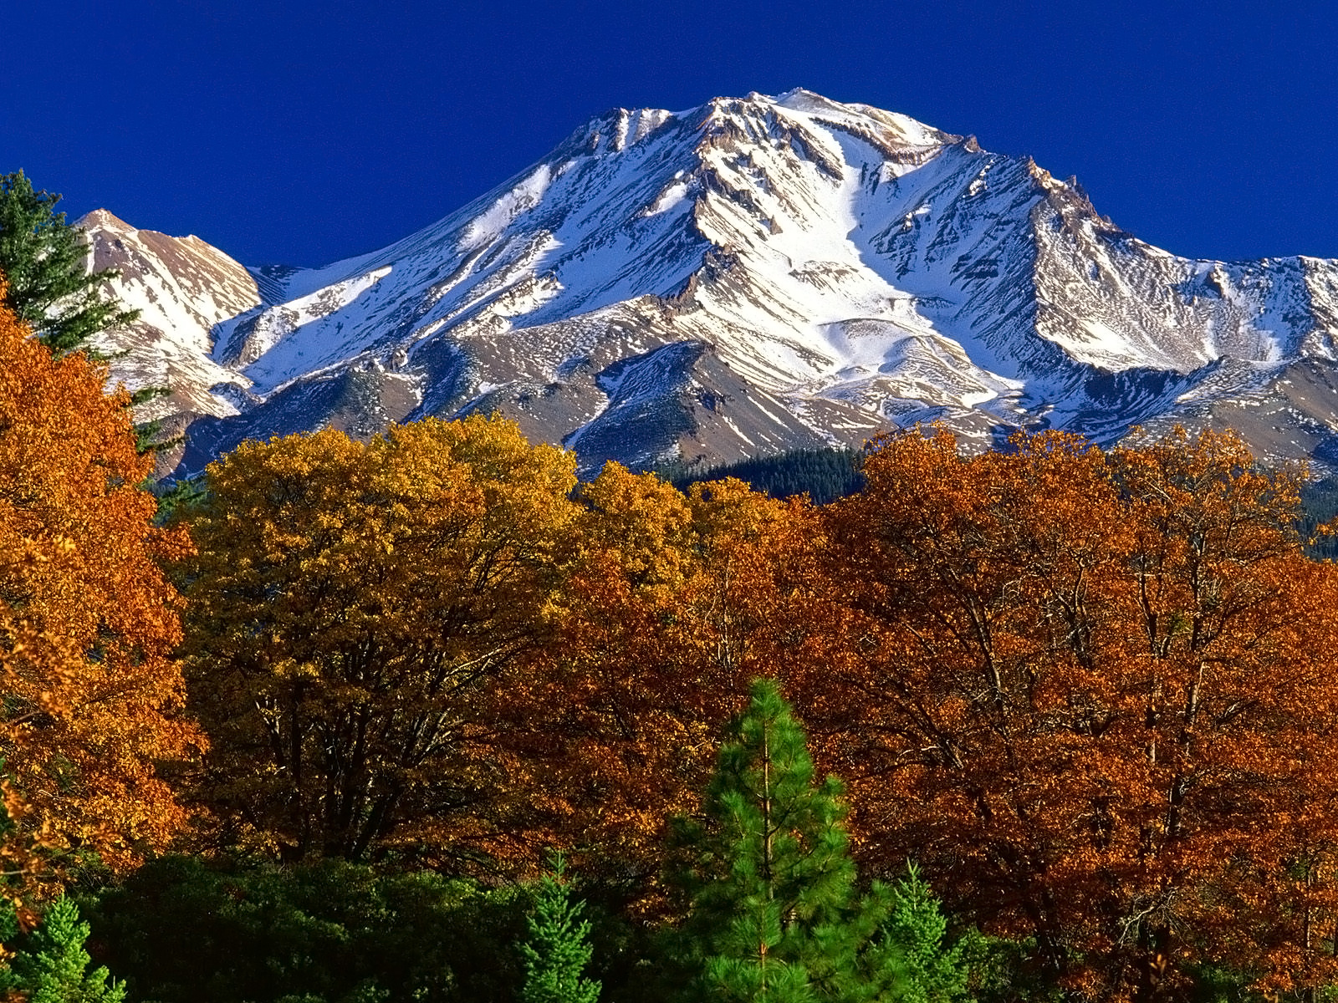
Mount Shasta

Slide 3
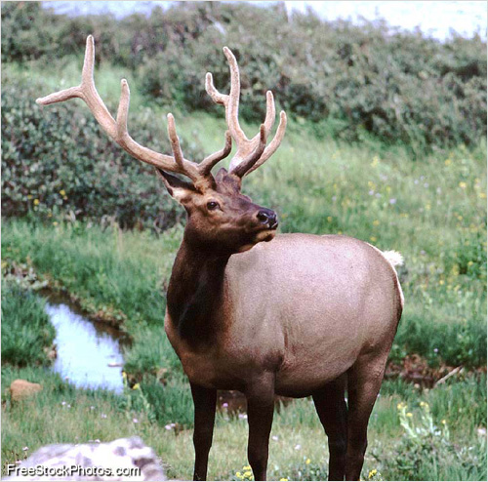
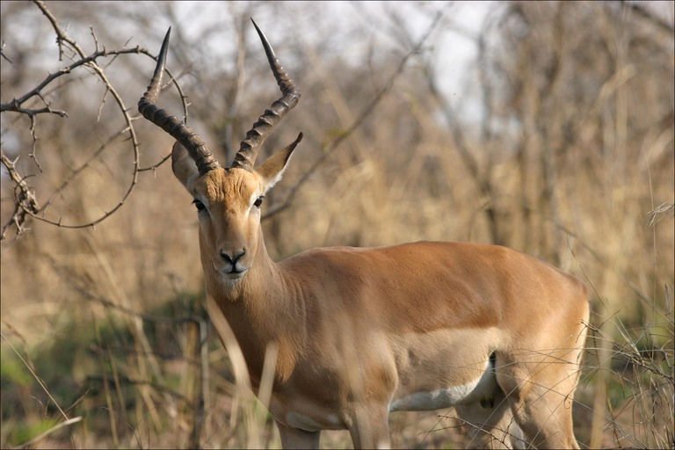
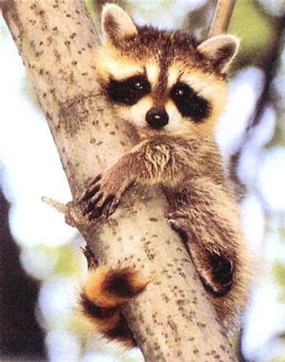
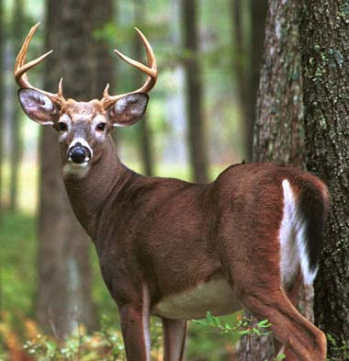
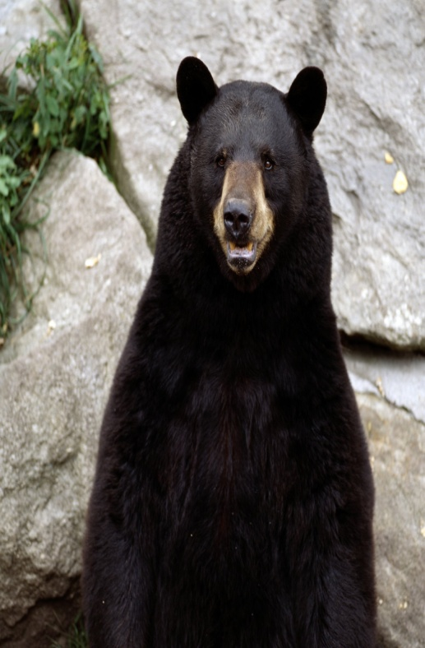
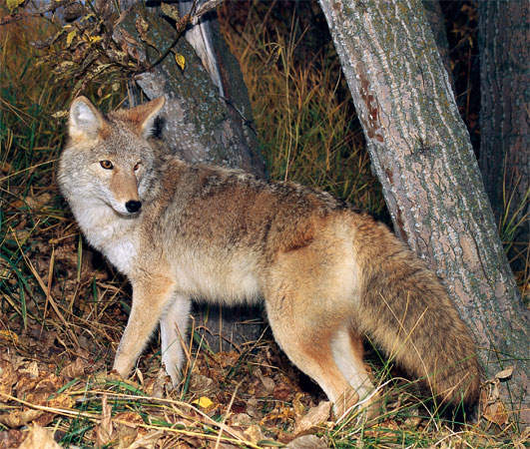
Animals found at Mt. Shasta
elk
antelope
raccoon
deer
bear
coyote

Slide 4
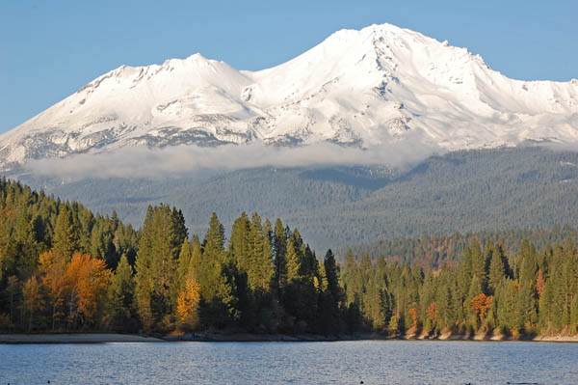
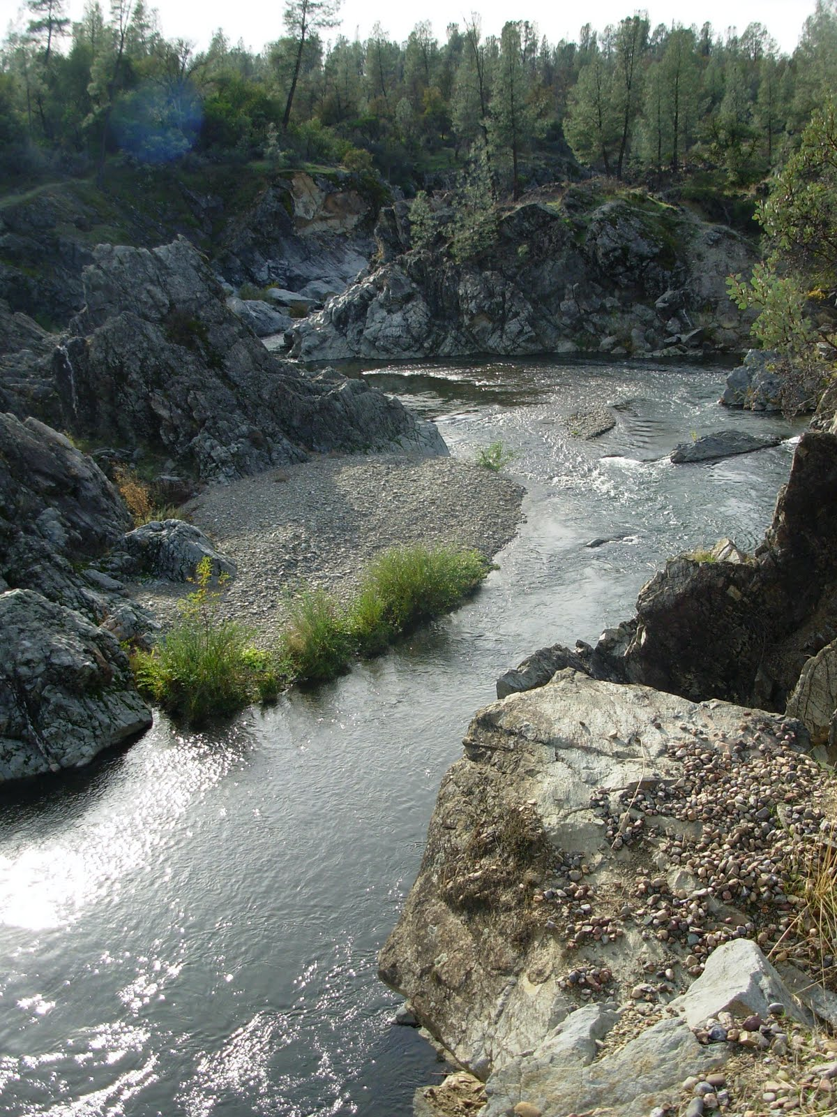
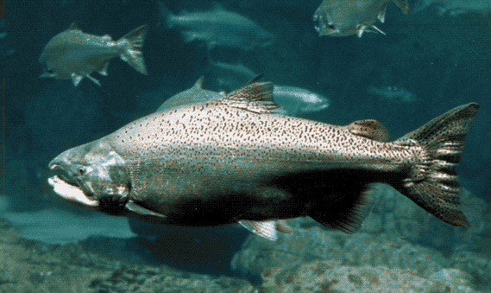
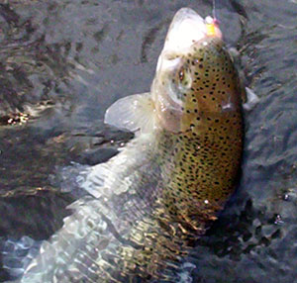
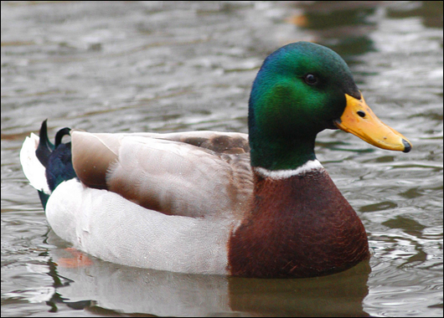
Lakes and Streams
salmon
duck
trout

Slide 5
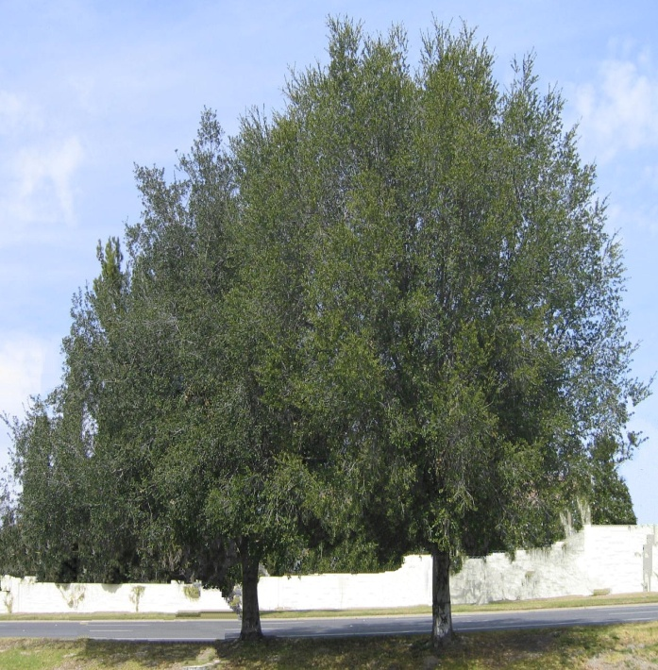
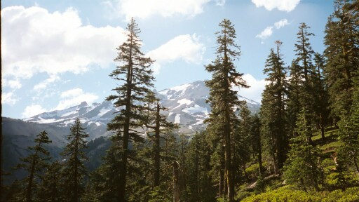
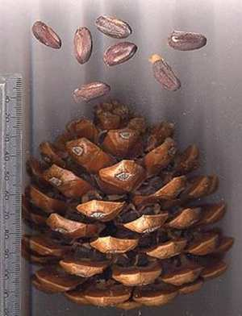
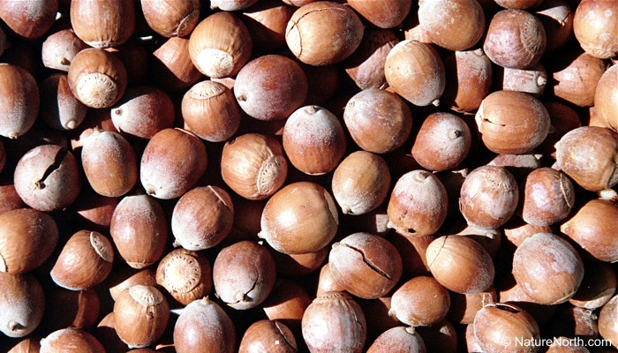
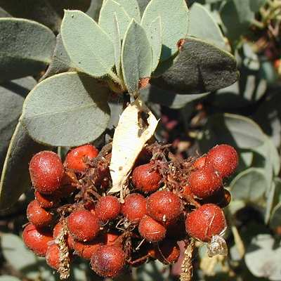
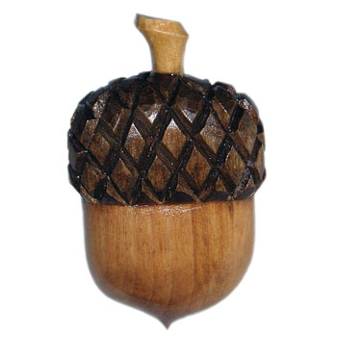
Plant Life at Mt. Shasta
Oak trees
Pine trees
Nuts and Berries

Slide 6
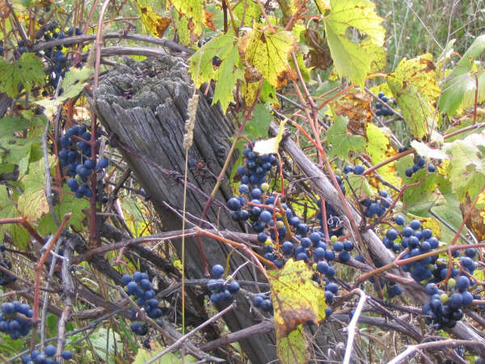
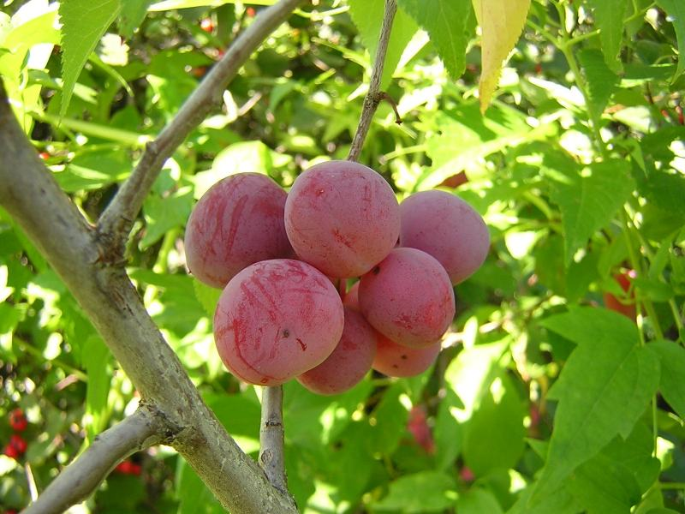
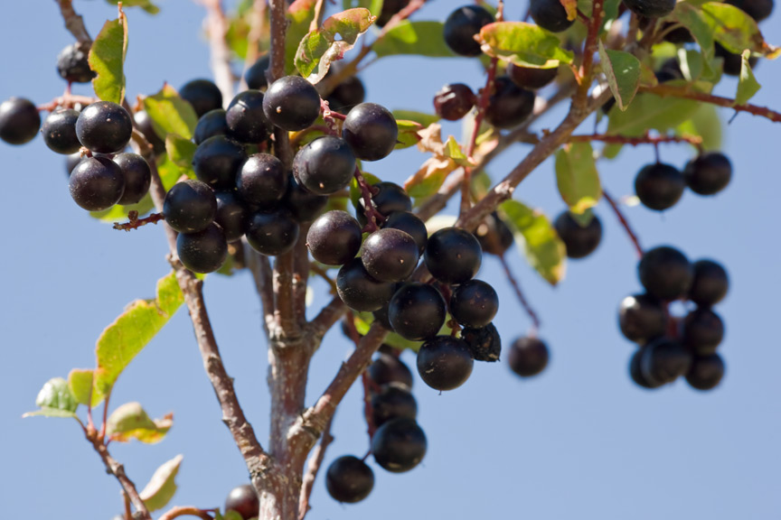
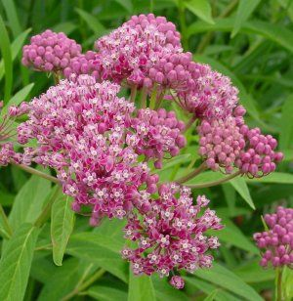
Wild grapes
Wild plums
Milkweed
chokecherries

Slide 7
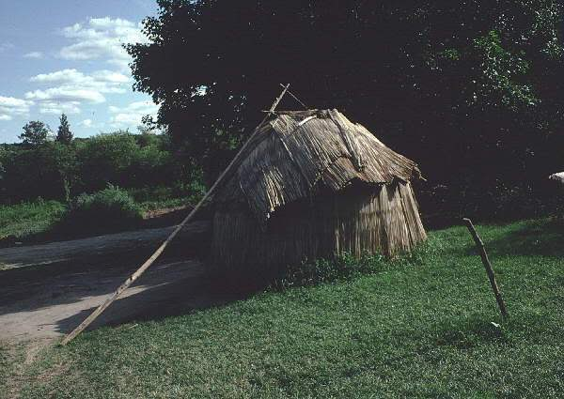
Shelter
2 kinds of houses
Winter: Umma – made from dirt and wood
Spring: homes made from brush or bark

Slide 8
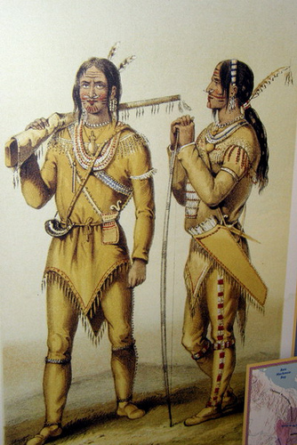
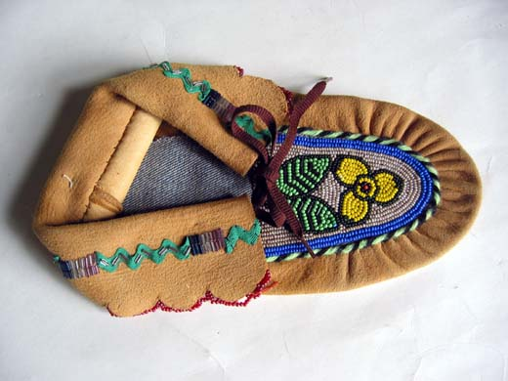
Clothing
Men and women wore shirts, small caps, and belts to keep warm
Men used leggings
Women usually wore skirts and aprons
Fur hats and fur leggings
Everyone wore moccasins

Slide 9
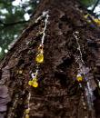

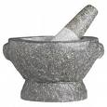
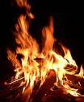
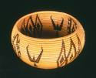
Arts and Crafts
They used stones to make tools, pestles, and bowls
They used plants like reeds and grasses to make baskets
Wood was used as fuel for fires and making for tools
Sap from the pine trees was used as glue
They made canoes out of the trees
They used animals to help make their clothing and tools

Slide 10
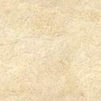
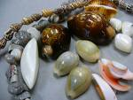
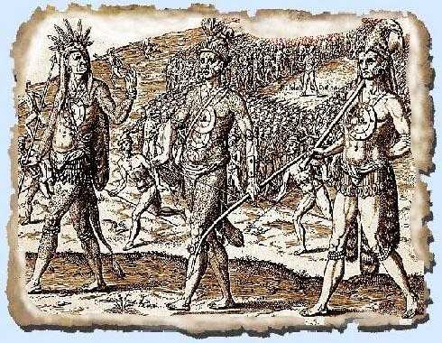
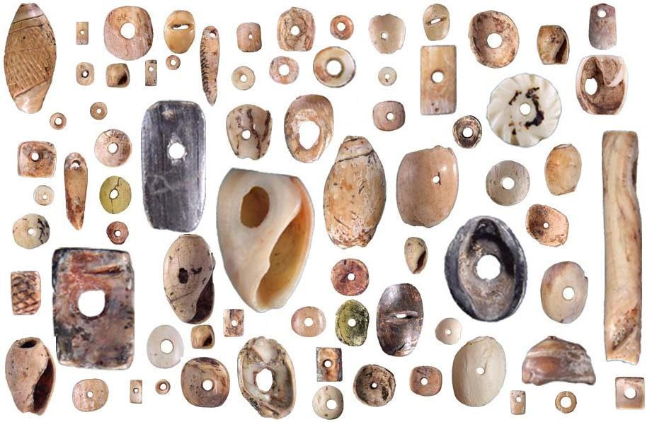
Trade
The Shasta traded with other tribes for resources they didn’t have in their region.
They used shell beads as money

Slide 11
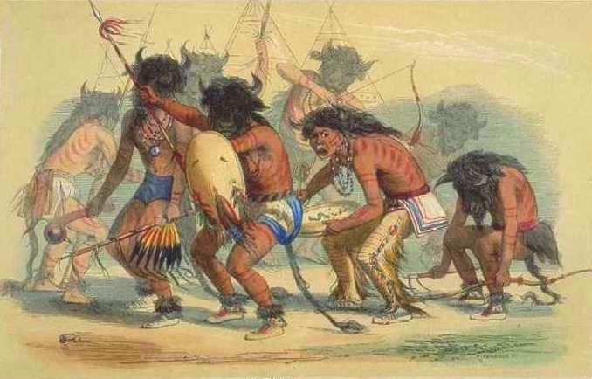
Religion
Many rituals and celebrations
Special rituals for boys and girls who turned 13, marriages, and births
Special rituals for funerals
Ceremonies for adults who became doctors, warriors, or leaders
Special beliefs about health

