Slide 1
Inside Out by: Francisco Jimenez

Slide 2
Active Instruction
Set the Stage
Rate and review the vocabulary words with your partner
preferred blended sketched
gestured embarrassed respond
Today we will continue to read Inside Out by Francisco Jimenez. As we read, we will compare and contrast information in the story. Good readers compare and contrast as they read to help them understand things that happen in the story.

Slide 3
Set the Stage
What are the three purposes for reading
Remember to fill in team score sheets
To be informed
To follow directions
To be entertained

Slide 4
Team Cooperation Goal: Active Listening
Eyes on the speaker
Hands on desk
Sitting up straight
Pay attention to what is being said

Slide 5

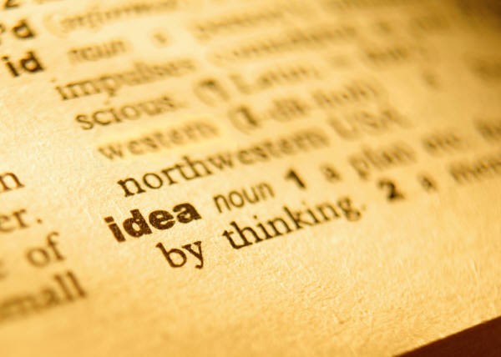
Vocabulary Celebration

Slide 6
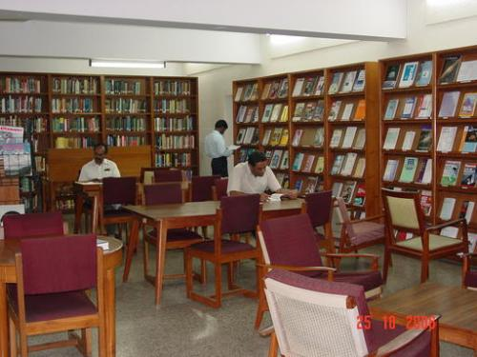
preferred
Liked better
John preferred books over movies so he spent most of her free time in the library.

Slide 7
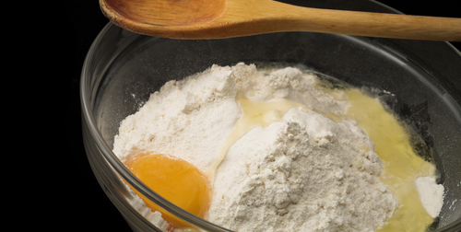
blended
blended
Cory blended milk, flour, and sugar to make the cake batter.

Slide 8
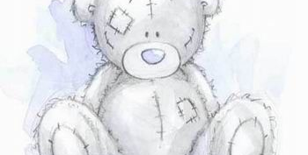
sketched
drew
Antonia sketched a picture in her drawing class of her favorite teddy bear Ralph.

Slide 9
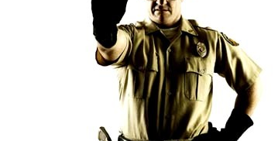
gestured
signaled
The policeman gestured to the car to go through the signal light.

Slide 10
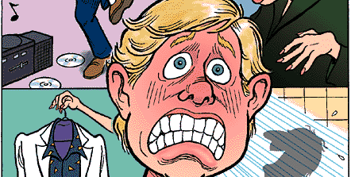
embarrassed
ashamed
Bobby was embarrassed when he tripped and fell as we were walking to class and everyone starting laughing.

Slide 11
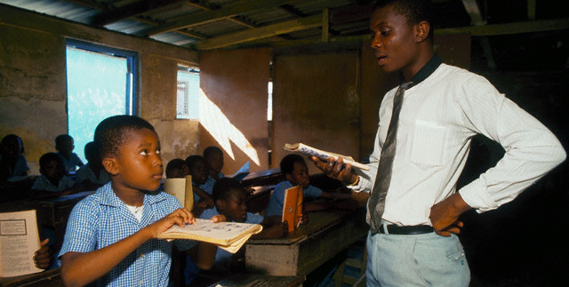
respond
answer
Charlie did not respond to the teacher when she asked a question because he didn’t know the answer.

Slide 12

Vocabulary Vault
gestured
preferred
embarrassed
blended
sketched
respond

Slide 13
Listening Comprehension
“Hungry Spider and the Turtle”
Page 109-110
Think Pair Share to compare and contrast Spider and Turtle.

Slide 14
Build Background
Comparing and Contrasting
Comparing is identifying how things are similar
Contrasting is identifying how things are different

Slide 15
Build Background
Who is Arthur?

Slide 16
Prepare to read
Preview Team Talk questions.
1. How did Mr. Sims help Francisco?
2. How did Curtis treat Francisco
a. nervously
b. generously
c. Cruelly
d. helpfully
3. Compare how Miss Scalapino treated both Francisco and Curtis
4. Why do you think Miss Scalapino was kinder to Francisco at the end of this section?
Which question is compare and contrast?

Slide 17
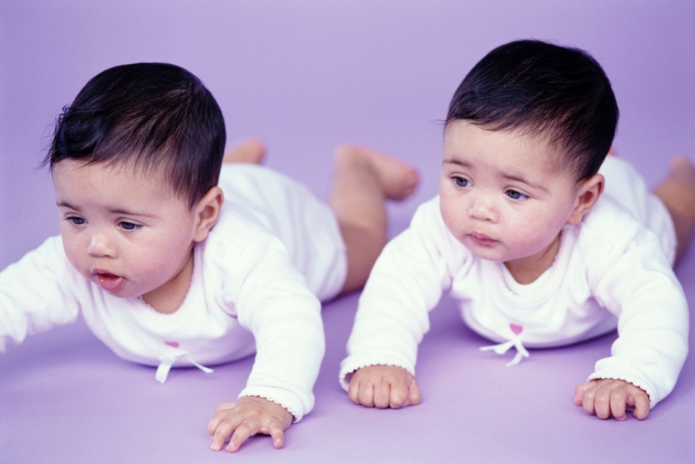
Teamwork – Partner reading
Read 151 and 153 with partner –
Clarify unknown words using sticky notes
Restate as you read

Slide 18
Team Discussion
Discuss and answer all Team Talk Questions – do not write any answer until all the questions have been discussed
1’s read questions
4’s answers questions
3’s agree or disagree
2’s summarize the correct answer
Write the answers to 1 and 4 in your journals

Slide 19

Class Discussion
Let’s celebrate our answers!

Slide 20
Adventures in Writing
What if you saw what happened between Curtis and Francisco? How would you respond to this situation? Give two details in your response.
  -You answer the question. 25 pts
  -Your answer explains or describes with
  at least two details 25 pts
  -Your answer makes sense and has part
  of the questions in it. 20 pts
  -Your answer is written in complete,
  correct answers 20 pts
  -Your writing has correct capitalization
  and punctuation. 10 pts
  TOTAL 100 PTS

Slide 21
Team Practice: Vocabulary
Cloze Practice- Fill in the blanks with the correct vocabulary word

Slide 22

Fluency
Practice reading page 149
Using the fluency rubric, practice fluency with your partner

