Slide 1
Learning Objective: 4L2 Compare and Contrast the Theme of Two Stories.
CFU
What are we going to do?
Vocabulary
¹ What does theme mean

Slide 2
What are we doing today?
Partner share
Today we will __________ and ________ theme of two stories.

Slide 3
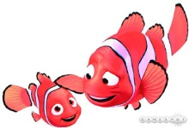
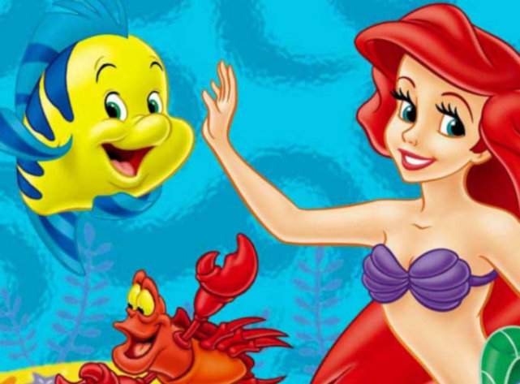
APK
Compare and contrast these two main characters? How are they the same? How are they different? Think about their experiences.

Slide 4
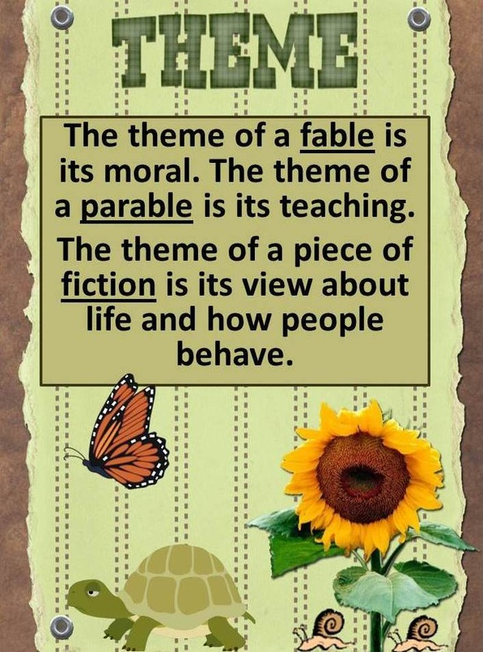
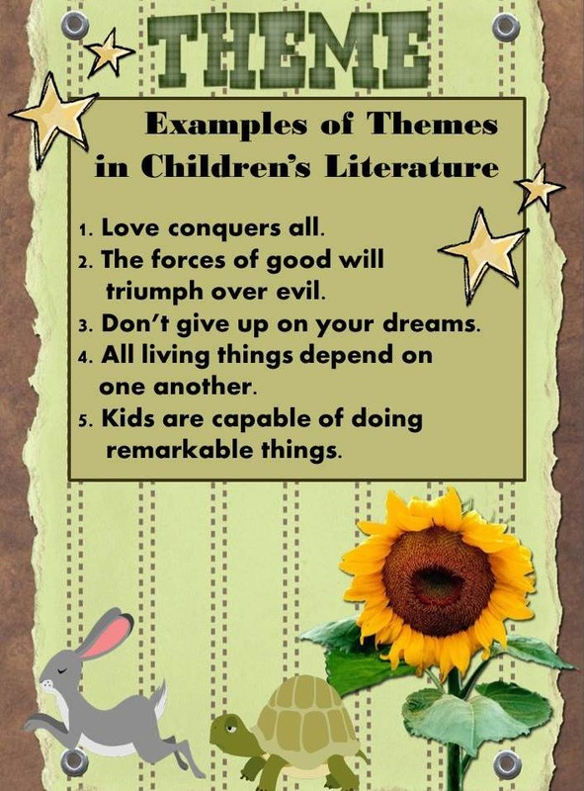
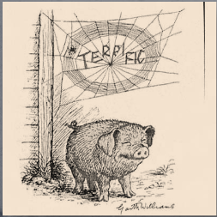
The theme of a story is its central idea or message about life. Sometimes the theme is expressed as a moral, or lesson, such as “look before you leap.”
Concept Development
CFU
What is another way of asking what theme is?
True friends are always there for you.
Moral- a lesson you learn from a story
Vocabulary

Slide 5

Sometimes you will be asked to compare and contrast themes (lessons) from 2 different stories.
When you want to identify the theme of both stories think of the following:
Concept Development
What are the characters doing and saying.
How do they change?
What do they learn?
What is the conflict that the main characters face?
Think about your own experiences. How would you act in this situation?
Compare and Contrast the Theme
What Theme do both stories share?
True friends can help get you through difficult time.
What is the main conflict that the characters face?
What do both characters learn?
CFU
Why is “A talking spider helps a pig not the theme?
What is the difference in how the theme is taught?

Slide 6
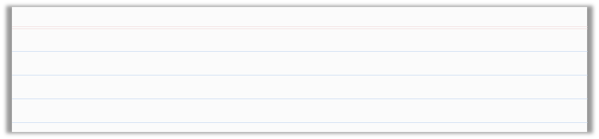
Skill Development/Guided Practice
What is one question that I
Can ask myself to help me compare and contrast the themes?
CFU
Compare and Contrast the themes.
1
What are the characters doing and saying.
How do they change?
What do they learn?
What is the conflict that the main characters face?
Think about your own experiences. How would you act in this situation?
2
3
Teacher Model Theme
 | Perseus and Medusa “Bring me the head of the monster woman Medusa!” the king said to Perseus. The king gave this command because he was sure that it was an impossible task for the young boy. Medusa had snakes for hair, and one look at her turned people to stone. The king knew that Perseus might never return if he attempted to follow the king’s command. Then the king would be free to marry Perseus’s mother. But Perseus knew that his mother disliked the king and would not marry him unless she was forced to. So Perseus decided to accept the king’s task. First he got a shield from the goddess Athena. Then he got a sickle from the god Hermes. Once in Medusa’s lair, he used the shield as a mirror to reflect Medusa’s head. He raised the sickle and brought it down. Perseus took the head to the king, who looked directly at it and turned to stone.
Thor’s Hammer
Long ago, in the far North, the thunder god Thor discovered that Thrym, the giant king, had taken his hammer. “To get your hammer back, you must bring Freya to be my bride,” Thrym demanded. The goddess Freya did not want to marry Thrym. The gods decided that Thor would dress as a bride and pretend to be Freya. Dressed as a bride, Thor went to Thrym’s cold mountain home. The disguise fooled Thrym. He ordered that Thor’s hammer be laid in the lap of the bride. At that, Thor grabbed his hammer, struck Thrym with it, and left the land of the giants.
What is the main conflict that the
characters face?
What do both characters learn?
What is the theme? What is your evidence?
What is the difference in how the theme is taught?

Slide 7
Theme
The message in both stories is that the key to successfully completing any task is to use one’s mind as well as one’s strength.
In “Thor’s Hammer,” Thor uses his mind to fool Thrym into believing that he is Freya. By doing so, he is able to get his hammer and defeat Thrym.
In “Perseus and Medusa” Perseus uses his mind by treating the shield as a mirror. By doing so, he does not have to look at Medusa directly. This helps him remove her head and defeat the king.

Slide 8
Skill Development/Guided Practice
What is one question that I
Can ask myself to help me compare and contrast the themes?
CFU
Compare and Contrast the themes.
1
What are the characters doing and saying.
How do they change?
What do they learn?
What is the conflict that the main characters face?
Think about your own experiences. How would you act in this situation?
2
3
Teacher Model Theme
 | A Greek Fable A wolf caught a young goat returning from the pasture. The goat knew that he couldn’t escape, but he thought that he could fool the wolf. The goat said, “I know that you’ll eat me, my friend, but I’d like just one favor from you. Would you play a tune so that I can dance once last time?” The wolf took out his pipes and played. Some dogs heard the music and became curious. They saw the wolf and began to chase him. The wolf knew that he’d been fooled. He said to the goat, “I got what I deserved; I’m a hunter, not a musician.
A Chinese Fable
A young man wanted to get a fox skin to please his new bride. He searched until he caught a fox by the tail. With great happiness at his success, he said to the fox, “My bride wants a fox coat. Can you give me your skin?” The fox recognized trouble and thought quickly about how to save himself. “I will be happy to do that, but I can’t help you when you hold my tail so tightly. Please let go, and I’ll immediately give you my skin.” The man let go, and the fox ran away laughing.
What is the main conflict that the
characters face?
What do both characters learn?
What is the difference in how the theme is taught?

Slide 9
The moral, or lesson, in both fables is that being smart can sometimes triumph over being strong.
In the Chinese fable, the fox realizes that he can’t escape, so he uses his mind to outsmart the young man.
In the Greek fable, the goat realizes that he can’t escape, so he uses his mind to outsmart the wolf.

Slide 10
Relevance
The theme of a story is its central idea or message about life. Sometimes the theme is expressed as a moral, or lesson.
1
Comparing (how they are the same) and contrasting (how they are different) the theme will help you connect with the story, drama, or poem you are reading and better understand the author’s purpose
Does anyone else have another reason why it is relevant (important) to compare and contrast themes in stories.
CFU

Slide 11
Skill Development/Guided Practice
What is one question that I
Can ask myself to help me compare and contrast the themes?
CFU
Compare and Contrast the themes.
1
What are the characters doing and saying.
How do they change?
What do they learn?
What is the conflict that the main characters face?
Think about your own experiences. How would you act in this situation?
2
3
Guided Practice
The Ant and the Butterfly An ant passed a butterfly in a cocoon, about to finish its change. The butterfly moved its tail, catching the ant’s attention. The ant saw the butterfly all wrapped up in its cocoon. The ant boasted, “Look at you, stuck there. You are not able to move while I can run and play.” The butterfly did not reply. A few days later, the ant passed the spot again. The butterfly was gone. Only the cocoon remained. The ant wondered what happened to the creature inside when above him, a beautiful butterfly spread its wings.“Boast now that you can run and play,” said the butterfly. He flapped his wings and flew high in the sky. | The Hare and the Tortoise One day a hare passed a tortoise plodding along on her way. The hare made fun of the tortoise’s short legs and slow pace. “I am twice as fast as you,” the hare boasted. “The tortoise said, “I may have short legs. I may not be as fast as you. Yet, I bet I can beat you in a race .”The hare laughed at such a silly idea. He quickly agreed to the race. During the race, the hare knew he would win. He was sleepy, so he decided to rest on the side of the road. The hare fell asleep. When he woke up, he hurried to finish the race. The tortoise had already crossed the finish line. “Slow and steady wins the race,” he said.
What are the main characters saying
In both stories?
What is the theme in both stories?
What is the difference in how the theme is taught?

Slide 12
Because they both boast about how much better they are than the butterfly and the tortoise, the ant and the hare don’t get the better things in life.
The difference between the two stories is in the way the themes are presented.

Slide 13
Skill Development/Guided Practice
What is one question that I
Can ask myself to help me compare and contrast the themes?
CFU
Compare and Contrast the themes.
1
What are the characters doing and saying.
How do they change?
What do they learn?
What is the conflict that the main characters face?
Think about your own experiences. How would you act in this situation?
2
3
Guided Practice
The Story of Anansi the Spider Anansi the spider was greedy. One day, Turtle came to visit as Anansi was about to eat his dinner. “What a nice dinner!” said Turtle. To be polite, Anansi had to offer to share the food. Still, he did not want to. “You can join me,” said Anansi. “But first, clean your hands.” Turtle’s hands were dirty. He went to the river and washed. When he came back, Anansi had started to eat.“Your hands are still dirty!” Anansi said. Turtle looked down. On his way back, he had walked through mud. So he went and washed again. When he returned, he found that Anansi had eaten all the food. | “Tomorrow you must come to my house to share my dinner,” said Turtle. The next day, a hungry Anansi met Turtle at the river. Turtle dove into the water to his home on the river bottom. Anansi jumped into the water and tried to swim down, but he was too light. Then, Anansi put stones in his pockets and sank down to Turtle’s home. Turtle had started to eat. Turtle looked at Anansi and said, “It is not polite to eat with your coat on. You must take it off.” Anansi took off his coat. Without the stones, he was light again. He floated up to the surface. From there, he watched Turtle finish his meal.

Slide 14
Skill Development/Guided Practice
What is one question that I
Can ask myself to help me compare and contrast the themes?
CFU
Compare and Contrast the themes.
1
What are the characters doing and saying.
How do they change?
What do they learn?
What is the conflict that the main characters face?
Think about your own experiences. How would you act in this situation?
2
3
Guided Practice
The Tale of Coyote and Hen One day, Coyote came upon Hen. She was sitting on a tree branch. Coyote was hungry. He decided that he would eat Hen. But how could he reach her? She was much too high in the tree. Coyote thought and thought. Then he had an idea. “Oh, Hen,” he sighed. “I am so happy! I bring great news.” She was interested, but she did not trust Coyote. “A treaty has been signed,” said Coyote. “All the animals have signed it. It says that we are all friends now. There will be no more fighting! Please come down from the tree. I am so happy. I would like to give you a big hug.” | “Ah,” thought Hen. Now she knew what Coyote was up to. “I would love to,” said Hen. “But I see that someone else is coming.” “Really?” asked Coyote. “Who is it?” “It is Dog,” said Hen. Coyote began to shake. Dog scared him. “He must have heard the news, too,” said Hen. “He looks so happy! His eyes are bright and he is so fast. I think he wants to hug you.” Coyote took off running as fast as he could. Up in the tree, Hen smiled.
What is the main conflict that the
characters face?
What do both characters learn?
What is the difference in how the theme is taught?

Slide 15
Theme
As a result of having their own trick played back on them, the trickster characters in both stories must learn an important lesson.
In “The Story of Anansi the Spider,” Anansi must learn not to be greedy. Because Anansi tricks Turtle to avoid having to share his dinner, he in turn is tricked by Turtle and doesn’t get to share Turtle’s dinner.
In the “The Tale of Coyote and Hen,” Coyote must learn that he can’t get what he wants by being dishonest. When he tries to get Hen out of the tree by playing a trick on her, Hen in turn plays the same trick on him to get him to leave.

